Slide 1
Digital Signal Processing(BEC-42)
Unit-2
Lecture-2
Impulse Invariant Method
Date:30/09/2020

Slide 2




IIR Filter Design by Impulse Invariant Method
Apply inverse Laplace Transform
Apply sampling
Apply Z- Transform

Slide 3

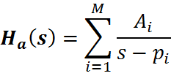
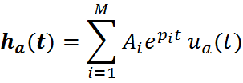

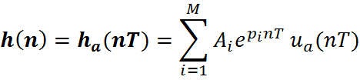
IIR Filter Design by Impulse Invariant Method
Desired impulse response of digital filter is obtained by uniformly sampling the impulse response of equivalent analog filter, that is
where T is sampling interval
Consider a simple distinct pole case for the analog filter
(1)
The impulse response system specified by equation 1 can be obained by taking inverse Laplace transform
After uniformly sampling of
(2)

Slide 4
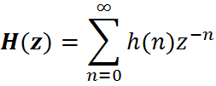
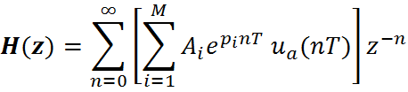
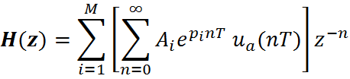
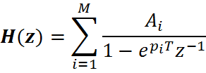
By taking the Z transform i.e.
Using equation 2
Interchanging the order of summation,
(3)

Slide 5









Now , by comparing equation 1 and 3, the mapping formula is given as
The above equation shows analog pole at mapped into digital pole at
Therefore
(4)
Substituting and expressing the complex variable z in the polar form as , the equation 4 becomes
=

Slide 6





LHP of s-plane is mapped inside the unit circle in the z-plane and RHP of s-plane is mapped outside of unit circle of z-plane.
The - axis mapped into the unit circle in z-plane.
Mapping from s-plane to z-plane
s-plane
z-plane

Slide 7




The mapping implies that
Frequency interval maps into the corresponding values
Frequency interval maps into the corresponding values
In general, any frequency interval maps into the corresponding values
The mapping from analog frequency to frequency is many to one.
Effect of aliasing due to sampling of impulse response.

Slide 8

Problem: Convert the analog filter into a digital filter whose system function is
Determine H(z) using impulse invariant method. Assume T=1s.

Slide 9





Solution: Using partial fractions, H(s) can be written as
=
=
When s=-2, then we get and when s=-1, then we get

Slide 10


So we can get
Now we use following relation
So we get

Slide 11

After simplifying the above equation and putting T=1s, we get the
answer as

